Slide 1
Denoising Autoencoders

Slide 2
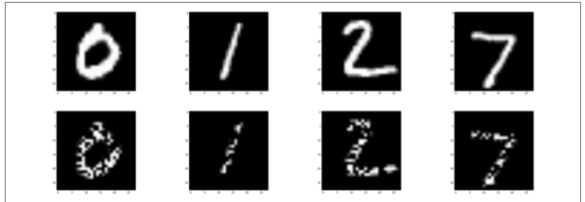
Denoising?
The human ability for perception is surprisingly resistant to noise.
Even though, half of the pixels are corrupted in each image, we still have no problem making out the digit. In fact, even easily confused digits (like the 2 and the 7) are still distinguishable

Slide 3
This phenomenon is based on probability. Even if we’re exposed to a
random sampling of pixels from an image, if we have enough
information, our brain is still capable of concluding the ground truth
of what the pixels represent with maximal probability.
Our mind is able to, quite literally, fill in the blanks to draw a conclusion.
Even though only a corrupted version of a digit hits our retina, our brain is still able to reproduce the set of activations (i.e., the code or embedding) that we normally would use to represent the image of that digit.
This is a property we might hope to enforce in our embedding algorithm, and it was first explored by Vincent et al. in 2008, when they introduced the denoising autoencoder.

Slide 4
The basic principles behind denoising are quite simple. We corrupt some fixed percentage of the pixels in the input image by setting them to zero.
Given an original input X, let’s call the corrupted version C (X)
The denoising autoencoder is identical to the vanilla autoencoder except for one detail: the input to the encoder network is the corrupted C (X) instead of X.
In other words, the autoencoder is forced to learn code for each input that is resistant to the corruption mechanism and is able to interpolate through the missing information to recreate the original, uncorrupted image.

Slide 5
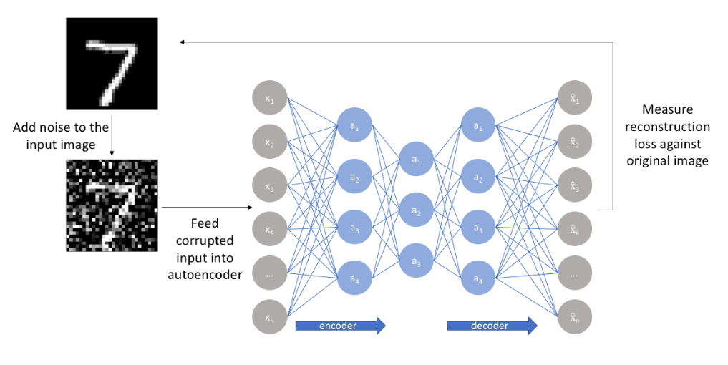

Slide 6
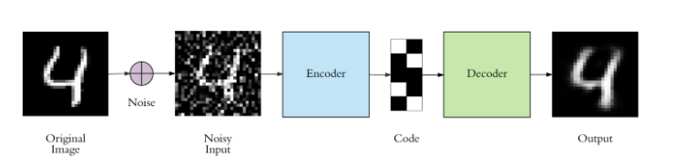

Slide 7
There is only one small difference between the implementation of denoising autoencoder and the regular one. The architecture doesn’t change at all, only the fit function. We trained the regular autoencoder as follows:
autoencoder.fit(x_train, x_train)
Denoising autoencoder is trained as:
autoencoder.fit(x_train_noisy, x_train)
Simple as that, everything else is exactly the same. The input to the autoencoder is the noisy image, and the expected target is the original noise-free one.

Slide 8
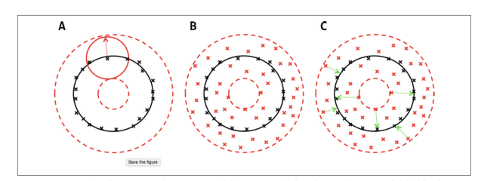
With this approach, our model isn't able to simply develop a mapping which memorizes the training data because our input and target output are no longer the same. Rather, the model learns a vector field for mapping the input data towards a lower-dimensional manifold The denoising objective enables our model to learn the manifold (black cir- cle) by learning to map corrupted data (red x’s) to uncorrupted data (black x’s) by minimizing the error (green arrows) between their representations

Slide 9
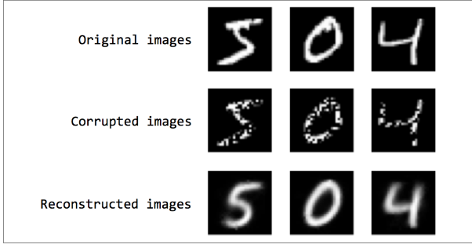

Slide 10
Sparsity in Autoencoders
One of the most difficult aspects of deep learning is a problem known as interpretabil-
ity.
Interpretability is a property of a machine learning model that measures how easy
it is to inspect and explain its process and/or output.
Deep models are generally very difficult to interpret because of the nonlinearities and massive numbers of parameters that make up a model.
While deep models are generally more accurate, a lack of interpretability often hinders their adoption in highly valuable, but highly risky, applications.
For example, if a machine learning model is predicting that a patient has or does not have cancer, the doctor will likely want an explanation to confirm the
model’s conclusion.
We can address one aspect of interpretability by exploring the characteristics of the
output of an autoencoder.
In general, an autoencoder’s representations are dense, and this has implications with respect to how the representation changes as we make coherent modifications to the input.

Slide 11
Sparse autoencoders offer us an alternative method for introducing an information bottleneck without requiring a reduction in the number of nodes at our hidden layers.
Rather, we'll construct our loss function such that we penalize activations within a layer.
For any given observation, we'll encourage our network to learn an encoding and decoding which only relies on activating a small number of neurons.
This is a different approach towards regularization, as we normally regularize the weights of a network, not the activations.

Slide 12
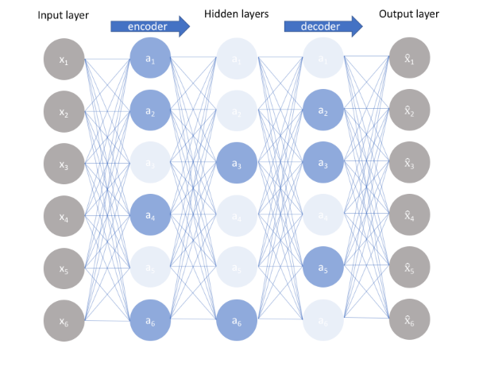

Slide 13
we allow our network to sensitize individual hidden layer nodes toward specific attributes of the input data.
Where as an undercomplete autoencoder will use the entire network for every observation, a sparse autoencoder will be forced to selectively activate regions of the network depending on the input data.

Slide 14
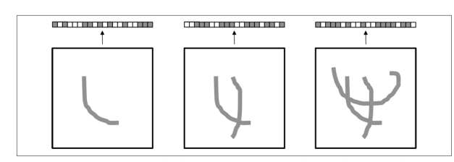
Example: The activations of a dense representation combine and overlay information from multiple features in ways that are difficult to interpret

Slide 15
Sparsity in Autoencoders
The autoencoder produces a dense representation, that is, the representation of the original image is highly compressed. Because we only have so many dimensions to work with in the representation, the activations of the representation combine information from multiple features in ways that are extremely difficult to disentangle.
The result is that as we add components or remove components, the output representation changes in unexpected ways.
It’s virtually impossible to interpret how and why the representation is generated in the way it is.

Slide 16
The ideal outcome for us is if we can build a representation where there is a 1-to-1 correspondence, or close to a 1-to-1correspondence, between high-level features and individual components in the code.
When we are able to achieve this, we get very close to the system described in next figure.
In this setup, it’s quite clear how and why the representation changes—the representation is the sum of the individual strokes in the image.

Slide 17
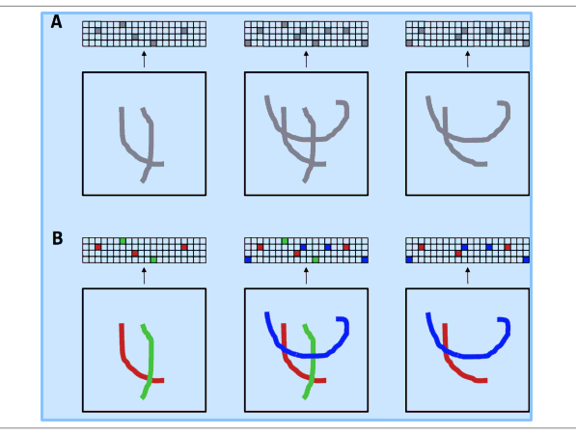
With the right combination of space and sparsity, a representation is more interpretable. In B, we color-code the activations that correspond to each stroke to highlight our ability to interpret how a stroke affects the representation

Slide 18

Here, we force the autoencoder to utilize as few components of the
representation vector as possible, while still effectively reconstructing the input.
This is very similar to the rationale behind using regularization to prevent overfitting in simple neural networks
We achieve this by modifying the objective function with a sparsity penalty, which increases the cost of any representation that has a large number of nonzero components:
The value of β determines how strongly we favor sparsity at the expense of generating Sparse better reconstructions

Slide 19

There are two main ways by which we can impose this sparsity constraint; both involve measuring the hidden layer activations for each training batch and adding some term to the loss function in order to penalize excessive activations. These terms are:
L1 Regularization: We can add a term to our loss function that penalizes the absolute value of the vector of activations a in layer h for observation i, scaled by a tuning parameter λ.

Slide 20
KL-Divergence: In essence, KL-divergence is a measure of the difference between two probability distributions. We can define a sparsity parameter ρ which denotes the average activation of a neuron over a collection of samples.
This expectation can be calculated as
where the subscript j denotes the specific neuron in layer h, summing the activations for m training observations denoted individually as x. In essence, by constraining the average activation of a neuron over a collection of samples we're encouraging neurons to only fire for a subset of the observations.

Slide 21
https://towardsdatascience.com/applied-deep-learning-part-3-autoencoders-1c083af4d798
https://web.stanford.edu/class/cs294a/sparseAutoencoder_2011new.pdf
https://towardsdatascience.com/deep-inside-autoencoders-7e41f319999f
https://towardsdatascience.com/generating-images-with-autoencoders-77fd3a8dd368

